Slide 1
CS422 Database systems
Today: Execution models for distributed computing – 1st generation
Data-Intensive Applications and Systems (DIAS) Laboratory École Polytechnique Fédérale de Lausanne

Slide 2
Previous weeks
Storage
Query operators and optimization
OLAP
Common challenge
how to handle the ever-increasing data sizes!

Slide 3
Overview
Big Data
Introduction to Hadoop & MapReduce
Architectural choices
The other side

Slide 4
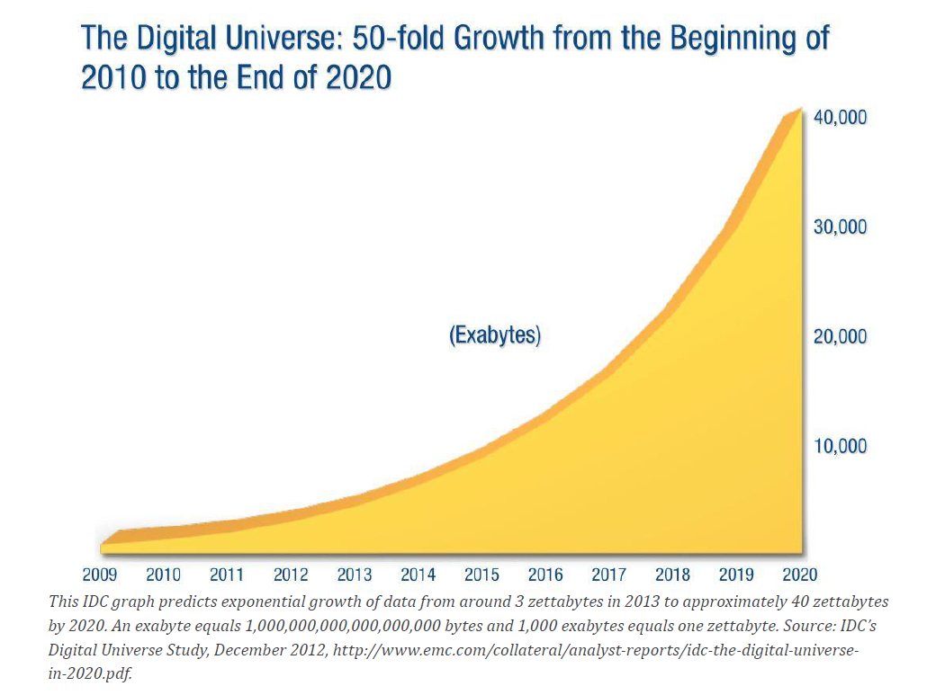
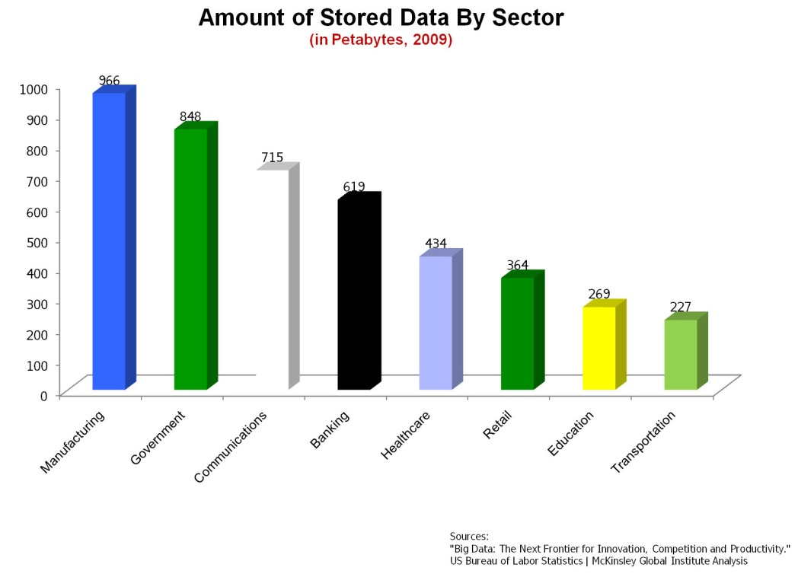
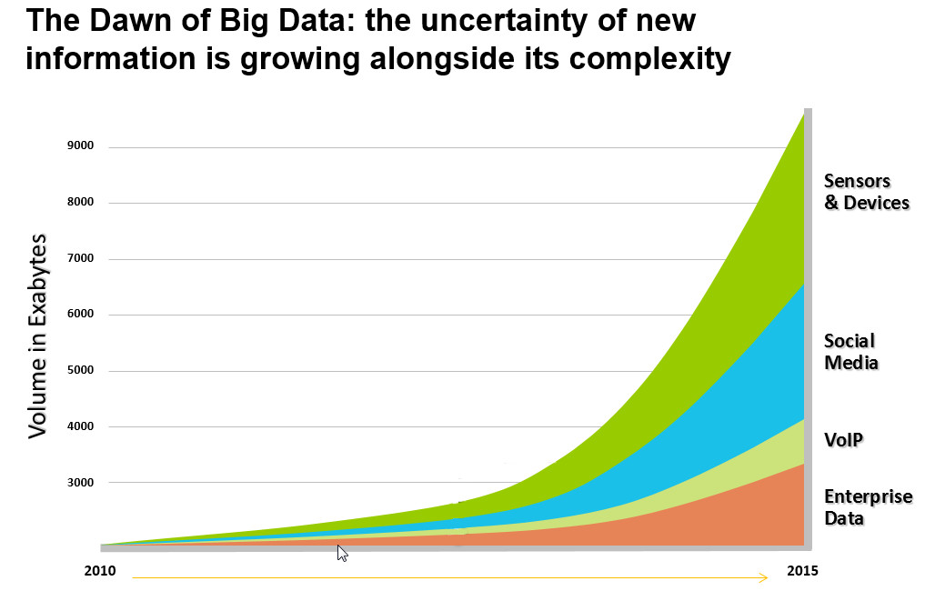
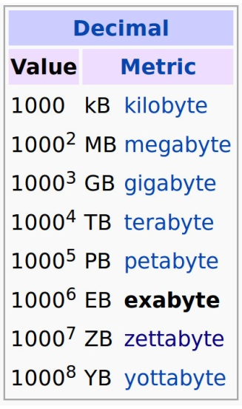
How big is “all” data?
http://www.tech-dynamics.com/wp-content/uploads/2014/02/BigDataChart.png

Slide 5
Big Data
The three (plus two) Vs: Big data is high volume, high velocity, and/or high variety information assets that require new forms of processing to enable enhanced decision making, insight discovery and process optimization
Volume: The quantity of generated and stored data.
Velocity: The speed at which the data is generated and processed.
Variety: The type and nature of the data.
Variability: Inconsistency of the data set.
Veracity: The quality of captured data.

Slide 6
The Gamma Parallel Database Machine (DeWitt, UW Madison)
Motivation
Physical System Designs
Data Clustering
Failure Management
Query Processing
Evaluation and Results
Bonus : Current Progress, Hadoop, Clustera.
UW EECS 584, Fall 2011
6
Notes:
6

Slide 7
No Shared Data Declustering
name
age
salary
Bob | 20 | 10K
Shideh | 18 | 35K
Ted | 50 | 60K
Kevin | 62 | 120K
Angela | 55 | 140K
Mike | 45 | 90K
Logical View
Physical View

Slide 8
No Shared Data Declustering
Spreading data between disks :
Attribute-less partitioning
Random
Round-Robin
Single Attribute Schemes
Hash De-clustering
Range De-clustering
Multiple Attributes schemes possible
MAGIC, BERD etc

Slide 9
No Shared Data Declustering
Spreading data between disks :
Attribute-less partitioning
Random
Round-Robin
Single Attribute Schemes
Hash De-clustering
Range De-clustering
Multiple Attributes schemes possible
MAGIC, BERD etc

Slide 10
Hash Declustering
name
age
salary
Bob | 20 | 10K
Shideh | 18 | 35K
Ted | 50 | 60K
Kevin | 62 | 120K
Angela | 55 | 140K
Mike | 45 | 90K
salary is the partitioning attribute.
salary % 3
name
age
salary
name
age
salary
name
age
salary
Ted | 50 | 60K
Kevin | 62 | 120K
Bob | 20 | 10K
Mike | 45 | 90K
Shideh | 18 | 35K
Angela | 55 | 140K

Slide 11
Hash Declustering
Selections with equality predicates referencing the partitioning attribute are directed to a single node:
Retrieve Emp where salary = 60K
Equality predicates referencing a non-partitioning attribute and range predicates are directed to all nodes:
Retrieve Emp where age = 20
Retrieve Emp where salary < 20K
SELECT *
FROM Emp
WHERE salary=60K
SELECT *
FROM Emp
WHERE salary<20K

Slide 12
Range Declustering
name
age
salary
Bob | 20 | 10K
Shideh | 18 | 35K
Ted | 50 | 60K
Kevin | 62 | 120K
Angela | 55 | 140K
Mike | 45 | 90K
salary is the partitioning attribute.
0-50K
51K-100K
101K-∞
name
age
salary
name
age
salary
name
age
salary
Bob | 20 | 10K
Shideh | 18 | 35K
Ted | 50 | 60K
Mike | 45 | 90K
Kevin | 62 | 120K
Angela | 55 | 140K

Slide 13
Range Declustering
Equality and range predicates referencing the partitioning attribute are directed to a subset of nodes:
Retrieve Emp where salary = 60K
Retrieve Emp where salary < 20K
Predicates referencing a non-partitioning attribute are directed to all nodes.
In the example, both queries are directed to one node.

Slide 14
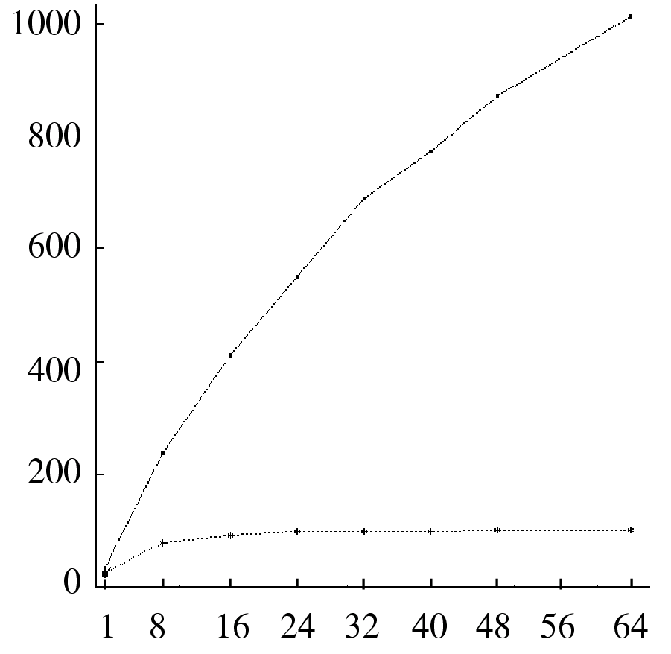
Declustering Tradeoffs
Range selection predicate using a clustered B⁺-tree
0.01% selectivity
(10 records)
Throughput
(Queries/Second)
Range
Hash/Random/Round-robin
Multiprogramming Level

Slide 15
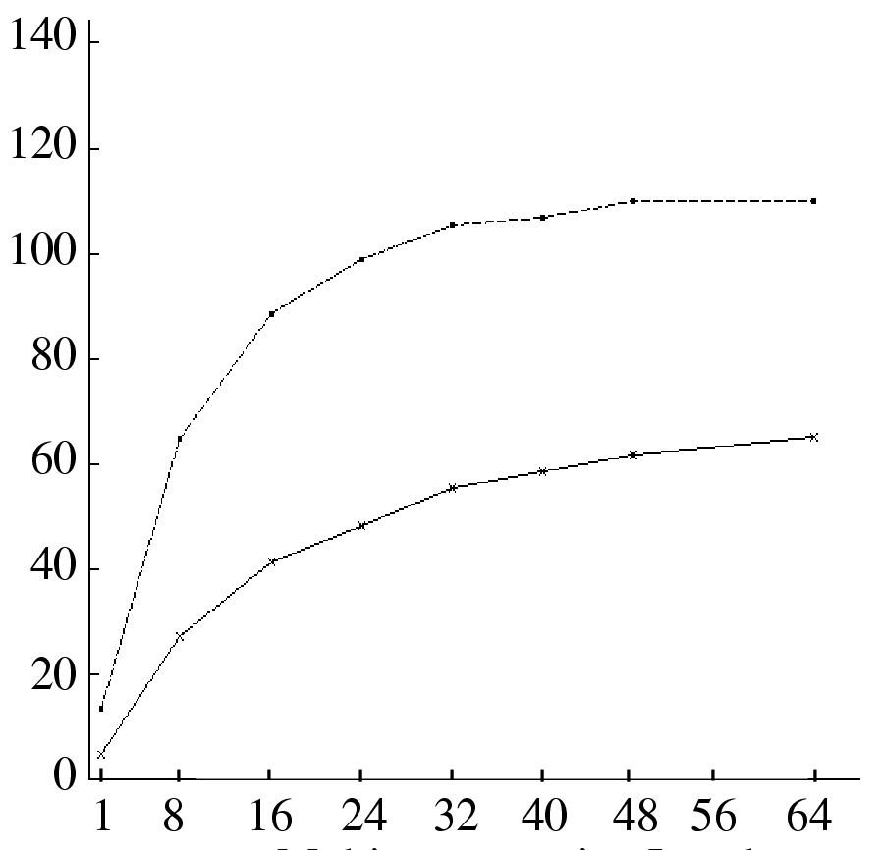
Declustering Tradeoffs
Range selection predicate using a clustered B⁺-tree
1% selectivity
(1000 records)
Throughput
(Queries/Second)
Hash/Random/Round-robin
Range
Multiprogramming Level

Slide 16
Declustering Tradeoffs
Why the difference ?
UW EECS 584, Fall 2011
16
Notes:
16

Slide 17
Declustering Tradeoffs
Why the difference ?
When selection was small, Range spread out load and was ideal
When selection increased, Range caused high workload on one/few nodes while Hash spread out load
4/3/2019
EECS 584, Fall 2011
17
Notes:
17

Slide 18
The Gamma Parallel Database Machine (DeWitt, UW Madison)
Motivation
Physical System Designs
Data Clustering
Failure Management
Query Processing
Evaluation and Results
Bonus : Current Progress, Hadoop, Clustera..
4/3/2019
EECS 584, Fall 2011
18
Notes:
18

Slide 19
Failure Management
4/3/2019
EECS 584, Fall 2011
19
Key Questions
Robustness (How much damage recoverable?)
Availability (How likely? Hot Recoverable?)
MTTR (Mean Time To Recovery)
Consider two declustering schemes
Interleaved Declustering (TeraData)
Chained Declustering (Gamma DBM)
Notes:
19

Slide 20
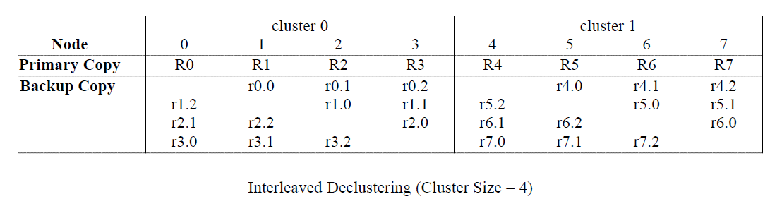
Interleaved Declustering
A partitioned table has a primary and a backup copy.
The primary copy is constructed using one of the partitioning techniques.
The secondary copy is constructed by:
Dividing the nodes into clusters (cluster size 4 here),
Partition a primary fragment (R0) across the remaining nodes of the cluster: 1, 2, and 3. Realizing r0.0, r0.1, and r0.2.
4/3/2019
EECS 584, Fall 2011
20
Notes:
20

Slide 21
Interleaved Declustering
On failure, query load re-directed to backup nodes in cluster
MTTR :
replace node
reconstruct failed primary from backups
reconstruct backups stored in failed node
Second failure before this can cause unavailability
Large cluster size improves failure load balancing but increases risk of data being unavailable
Notes:
21

Slide 22
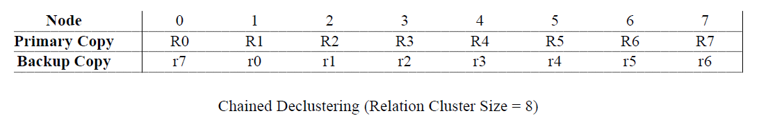
Chained Declustering (Gamma)
Nodes are divided into disjoint groups called relation clusters.
A relation is assigned to one relation cluster and its records are declustered across the nodes of that relation cluster using a partitioning strategy (Range, Hash).
Given a primary fragment Ri, its backup copy is assigned to node (i+1) mod M (M is the number of nodes in the relation cluster).
Notes:
22

Slide 23
Chained Declustering (Gamma)
During normal operation:
Read requests are directed to the fragments of primary copy,
Write requests update both primary and backup copies.
Notes:
23

Slide 24
Chained Declustering (Gamma)
In presence of failure:
Both primary and backup fragments are used for read operations,
Objective: Balance the load and avoid bottlenecks!
Write requests update both primary and backup copies.
Note:
Load of R1 (on node 1) is pushed to node 2 in its entirety.
A fraction of read request from each node is pushed to the others for a 1/8 load increase attributed to node 1’s failure.
Notes:
24

Slide 25
Chained Declustering (Gamma)
MTTR involves:
Replace node 1 with a new node,
Reconstruct R1 (from r1 on node 2) on node 1,
Reconstruct backup copy of R0 (i.e., r0) on node 1.
Note:
Once Node 1 becomes operational, primary copies are used to process read requests.
Notes:
25

Slide 26
Chained Declustering (Gamma)
Any two node failures in a relation cluster does not result in data un-availability.
Two adjacent nodes must fail in order for data to become unavailable
Notes:
26

Slide 27
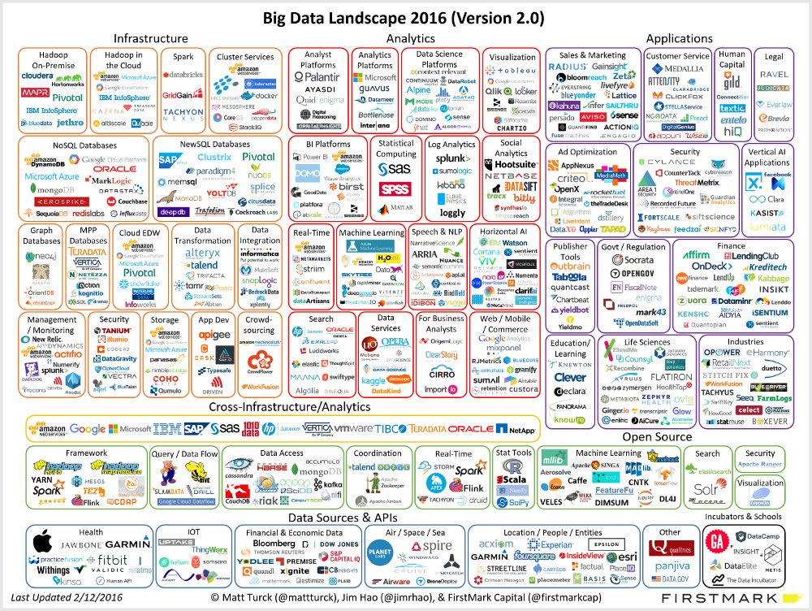

Slide 28
Mainstream Big Data models
How to store, manage and process Big Data by harnessing large clusters of commodity nodes
MapReduce family: simpler, more constrained
2nd generation: enables more complex processing & data, optimization opportunities
HadoopDB
Google
Pregel
Microsoft
Dryad

Slide 29
The Hadoop ecosystem
Ambari
(Management)
Zookeeper
(Distr. configuration, naming, …)
Yarn
(Resource management)
Pig
(Data Flow)
Hive
(SQL)
Programming
languages
MapReduce
(Distr. Programming Framework)
Computation
HCatalog
(Meta Data)
HBase
(Col. storage)
Table
storage
HDFS
(Hadoop Distr. File System)
Object
storage

Slide 30
Architectural choices of Hadoop
Storage layer
Hadoop HDFS
Programming model & exec. engine
Scheduling
Optimizations
Fault tolerance

Slide 31
Storage layer
Desiderata
Scalability: Handle the ever-increasing data sizes
Efficiency: Fast accesses to data
Simplicity: Hide complexity from the developers
Fault-tolerance: Failures do not lead to loss of data

Slide 32
HDFS abstractions
HDFS provides the illusion of a centralized file system
Developers are NOT reading from/writing to files explicitly. HDFS handles IO transparently.
E.g., MapReduce operates on file splits/partitions, which are received as inputs of Map/Reduce
$ hdfs dfs -cat hdfs://nn1.example.com/abc
$ hdfs dfs –copyFromLocal abc hdfs://nn1.example.com/abc
$ hdfs dfs –copyToLocal hdfs://nn1.example.com/abc abc
…
public void map(LongWritable key, Text value,
Context con) {
…
con.write(outputKey,outputValue);
}

Slide 33
HDFS & MapReduce
HDFS leveraged MapReduce execution engine for
Saving all input & intermediary files and final results
Robust communication across the cluster nodes
Replication in the context of fault tolerance & load balancing

Slide 34
HDFS replication
Files partitioned into blocks (typically 64 MB)
Blocks distributed and replicated across nodes
Three types of nodes in HDFS
Name nodes: Keep the locations of blocks
Secondary name nodes: backup nodes
Data nodes: keep the actual blocks

Slide 35
HDFS replication (2)
Files partitioned into blocks (default: 64 Mb each)
Blocks replicated across different nodes
1
2
3
4
5
6
7
8
1
2
5
1
3
4
4
5
7
2
3
6
8
6
8
7
DN 1
DN 2
DN 3
DN 4

Slide 36
HDFS failures
Detect failed data nodes with heartbeats
On failure, name node removes the failed data nodes from the index
Lost partitions are re-replicated to the remaining data nodes
1
2
5
1
3
4
4
5
7
2
3
6
X
8
3
4
6
8
6
7
1
DN 1
DN 2
DN 3
DN 4

Slide 37
HDFS evaluation
Scalability: Handle the ever-increasing data sizes?
Just add more data nodes
Efficiency: Fast accesses to data?
Everything read from HDD -- still requires I/O
Simplicity: Hide complexity from the developers?
Developer does not need to know where each block is stored
Fault-tolerance: Failures lead to loss of data?
Administrator can control replication
If failures are not widespread, no data is lost

Slide 38
Architectural choices of Hadoop
Storage layer
Programming model & exec. engine
The vision
MapReduce
Scheduling
Optimizations
Fault tolerance

Slide 39
The vision…
Sample function: convert all text to upper case
Splits may be
stored at diff. nodes
Huge
data
file
split 1
Map
out 1
Result
split 2
Map
out 2
U
split 3
Map
out 3
split 4
Map
out 4
split 5
Map
out 5

Slide 40
The vision (2)
More complicated: the word-count problem
Huge file → extract frequencies of words
Example
Extracted frequencies:
<Logic,1>, <will,2>, <get,1>, <you,2>, …
Logic will get you from A to B.
Imagination will take you everywhere.
Einstein once
said…

Slide 41
The vision (3)
Sample application: the word-count example
Huge
data
file
split 1
Map
Result
Map
Reduce
out 1
split 2
Reduce
out 2
U
split 3
Map
Repeated
for all
Reduce
out 3
split 4
Map
split 5
Map
Merging of
results
grouped by word
Local
computation

Slide 42
MapReduce programming model
Data model: everything is a <key,value> pair
Programming model - two core functions
Map(key,value): Invoked for every split of the input data. Value corresponds to the split.
Reduce(key,list(values)): Invoked for every unique key emitted by Map. List(values) corresponds to all values emitted from ALL mappers for this key.
→ parallelism and deployment handled by the system

Slide 43
MapReduce programming model (2)
The word-count problem
Input: Text file, broken in splits
Output: Frequency of each word observed in the file
Map(key,value): value: a split of the text file
for each word in value
emit pair <word,+1>
Reduce(key,list(values)): Key: word, values: list of (+1’s)
count=0
for each value in list(values)
count+=value
emit pair<key,count>

Slide 44
Sample code for word-count
private Text word = new Text(); public void map(Object key, Text value, Context context){
StringTokenizer itr = new StringTokenizer(value.toString());
while (itr.hasMoreTokens()) {
word.set(itr.nextToken());
context.write(word, new IntWritable(1));
}
---
public void reduce(Text key, Iterable<IntWritable>values, Context context) {
int sum = 0;
for (IntWritable val : values) {
sum += val.get();
}
result.set(sum);
context.write(key, result);
}
one item
in the list
Only relevant code is shown here. Full example online

Slide 45
MapReduce – under the hood
Shuffle phase
Map
phase
Sort Send Merge
Reduce
phase
DFS
DFS
<Logic,1>
<Logic,{1}>
<Logic,1>
Input data
Reduce
Split
Map
<will,1>
<will,{1,1}>
<will,2>
<get,1>
…
…
…
Split
Map
<Imagi…,1>
<get,{1}>
<get,1>
Reduce
<will,1>
<Imag..,{1}>
<Imagi…,1>
<take,1>
<take,{1}>
<take,1>
…
…
…
Intermediary results are saved as
regular files in HDFS. Is this good?
for each word in value
emit pair <word,+1>
for each value in list(values)
count+=value
emit pair<word,count>

Slide 46
MapReduce – under the hood (2)
Shuffling consumes network and causes delays
Idle time for CPUs
Progressive shuffling
Phases partially overlap: reducers start before maps fully complete
Node 1
Map
Reduce
Node 2
Map
Reduce
Node 3
Map
Reduce
Is it possible that a reducer completes before all mappers/shuffling complete?
Time

Slide 47
HDFS & MapReduce
Master-slave architecture
Namenodes, JobTrackers, TaskTrackers
Figure from
https://blogs.msdn.microsoft.com/avkashchauhan/2012/02/24/master-slave-architecture-in-hadoop/

Slide 48
MapReduce is not a panacea
MapReduce simple but weak for some reqs.
Cannot define complex processes
Batch mode, acyclic, not iterative
Everything file-based, no distributed memory
Procedural → difficult to optimize
Examples
Iterative processes, e.g., clustering
Real-time answers, e.g., streams
Graph queries, e.g., shortest path

Slide 49


Slide 50
Architectural choices of Hadoop
Storage layer
Programming model & exec. engine
Scheduling
Data locality
Different schedulers
Optimizations
Fault tolerance

Slide 51
Scheduling
Decisions to be taken
When to execute tasks
Where to execute tasks
How many resources to devote on each task
Multi-tenant platforms: how to share resources
Primary goal
Maximize data locality: move code to the data
Three options for shipping data
(a) Node-local, (b) Rack-local, (c) Different rack

Slide 52
Importance of data locality
Map
phase
Reduce
phase
Map
phase
Reduce
phase
Shuffle
Shuffle
Node 1
Node 1
Split
Map
Reduce
Split
Map
Reduce
Split
Map
Reduce
Split
Map
Reduce
Split
Map
Reduce
Split
Map
Reduce
Node 3
Node 3
Double-lined boxes denote node boundaries
Data shipping cost usually dominates

Slide 53
Scheduling (2)
Delay scheduler: further promotes data locality
Wait for some time until you decide to move data
to another node in the same rack
to a node in a different rack
If wait < T1, only allow node-local tasks
If T1 < wait < T2, also allow rack-local
If wait > T2, also allow different rack

Slide 54
Without delay scheduling – map only
Node 1
Node busy – Job 2
Node 2
Node busy – Job 2
Node 3
Node busy – Job 1
Node 4
Node busy – Job 2
Time
Job 2
Done
Move/copy data when node is busy
Copying delays both job 1 and job 2
Network usage, Node 4 also occupied

Slide 55
With delay scheduling – map only
Node 1
Node busy – Job 2
Node 2
Performance
gain
Node busy – Job 2
Node 3
Busy – Job 1
Node busy – Job 2
Node 4
Time
Job 2
Done
Wait for a bit until node 3 is freed
Job 1 completes sooner, job 2 starts/completes sooner
No data moved for map phase
Challenge: how long to wait

Slide 56
Scheduling (3)
Schedulers for multi-tenant platforms
FIFO scheduler – naïve first approach
Hadoop early scheduler & Spark’s standalone scheduler
Jobs are served First-in, first-out
Each job exploits all available nodes
Fair scheduler: fairness on resource usage
All jobs get ~ the same time
Capacity scheduler: fairness among users
All users get ~ the same time

Slide 57
Architectural choices of Hadoop
Storage layer
Programming model & exec. engine
Scheduling
Optimizations
Programming model
Execution engine
Fault tolerance

Slide 58
Programming model optimizations
HadoopToSQL: Static code analysis to identify declarative constructs → more optimization opportunities!
function map(LogEntry)
emit pair <LogEntry.Country,+1>
function reduce(Country,list(values))
count=0
for each value in list(values)
count+=value
emit pair<country,count>
SELECT Country, Count(*) FROM LogEntry GROUP BY Country

Slide 59
Programming model optimizations (2)
DryadLINQ: Annotations to discover decomposable UDFs → eager aggregation, less network, less CPU
Associative-decomposable function: Function H can be expressed as a composition of two functions I and C, such that:
H(x1⊕x2) =C(I(x1⊕x2)) =C(I(x1)⊕I(x2))
I is commutative: I(x1 ⊕ x2) = I(x2 ⊕ x1)
C is commutative & associative C(x1 ⊕ x2) = C(x2 ⊕ x1) & C(x1 ⊕ C(x2 ⊕ x3)) = C(C(x1 ⊕ x2)⊕x3))
⊕:concatenation
x1,x2:subsets

Slide 60
Decomposable UDFs in DryadLINQ
Associative-decomposable functions
initial reduction at each node
combine
final reduction
Eager aggregation
Less network
Less CPU
Can you rewrite the MR code of slide 38 such that it becomes decomposable?

Slide 61
Execution engine optimizations
Data locality
Data shipping cost typically dominates
Move computation to data
Run-time/dynamic optimizations
Dynamically change number of mappers/reducers
Increase mappers at beginning of job
Increase reducers at end of the job
Load balancing – carefully choose replica
Dryad: Change layout to enable partial aggregation and reduce network traffic between racks

Slide 62
Execution engine optimizations (2)
Handling of stragglers
Hardware heterogeneity, data skew, multi-tenancy, failures, …
Speculative execution – execute redundant copies of the task on idle nodes → get the one that completes first
Something
wrong with
node 3
Performance
gain
Node 1
job 1.A
Node 2
job 1.B
X
Node 3
job 1.C
Node 4
job 1.C’
Does speculative execution always help?
Time

Slide 63
Design choices of Big Data systems
Storage layer
Programming model & exec. engine
Scheduling
Optimizations
Fault tolerance

Slide 64
Fault tolerance
Hardware/software failures are the rule
Heterogeneous hardware
Can be low-end, cheap, unstable
Network size can be in the order of thousands
Data skew
Bugs!
Requirements
Data safety
Job recovery
Minimize effort – recompute as less as possible
Mask failures – do not delay the user!

Slide 65
Data safety
Data replication
Full copies
Copy data splits
In the same rack
In different racks
Controlled degree of replication

Slide 66
Job recovery in MapReduce
Intermediary results saved in replicated files!
Recompute the failed maps or reduces, only on the splits that failed!
X
X

Slide 67
Extra material - Scepticism

Slide 68
MapReduce: A major step backwards
Dimensions to examine
Programming paradigm
Implementation
Novelty
Features
Compatibility
Blog post by D. DeWitt and M. Stonebraker, 17 Jan. 2008

Slide 69
Programming paradigm
MapReduce does not support:
Data schema
Best way to protect the data
Separation of schemas from application
MR developer extracts structure by examining the code
No system catalogue
High-level access languages
Offer ease of use & optimization opportunities
The SQL-Codasyl debate revisited

Slide 70
Implementation
MapReduce is poorly implemented
Lacks fundamental big data capabilities
Brute-force vs indexes
Optimizer
Data skew kills parallelism
Data interchange severely unoptimized
Heavy I/O & network
Rare that a MapReduce solution will beat an Oracle solution on SQL-like workload

Slide 71
Novelty
MapReduce is not novel
Techniques are more than 20 years old
See parallel databases, distributed joins, data management over shared-nothing clusters, …
Teradata – commercial scale-out DBMS since the 80s
Expressivity
SQL & stored procedures & user defined aggregates

Slide 72
Features
MapReduce is missing fundamental features
Bulk loading
Indexing
Updates
Transactions
Integrity constraints & referential integrity
Views

Slide 73
Compatibility
MapReduce is incompatible with existing DBMS tools
Reports
BI tools
Data mining tools
Replication tools
DB design tools

Slide 74
Summary
40+ years of breakthroughs and lessons in databases largely ignored
Need schema
Need declarative language
Not so novel
Still a long way to go for MapReduce to reach maturity of DBMS

Slide 75
Open problems!
Scaling across multiple distributed clusters
Reducing network
Deciding on data and task location
Scheduling and resource sharing
Across tasks, users, applications
Powerful/expressive programming models
Improving performance & admin. cost
Performance of these systems still lacks performance of RDBMS for comparable hardware!!!
Administration cost also worse

Slide 76
Reading material
Jeffrey Dean, et. al.: MapReduce: simplified data processing on large clusters. Commun. ACM 2008 https://static.googleusercontent.com/media/research.google.com/en//archive/mapreduce-osdi04.pdf
Shivnath Babu, Herodotos Herodotou: Massively Parallel Databases and MapReduce Systems. Foundations and Trends in Databases 5(1): 1-104 (2013). Section 4. Available online at http://www.nowpublishers.com/article/Details/DBS-036
DeWitt and Stonebreaker: MapReduce: A major step backwards. https://homes.cs.washington.edu/~billhowe/mapreduce_a_major_step_backwards.html
Parquet Overview: https://www.slideshare.net/julienledem/parquet-overview

